Slide 1

Online Data Analysis (Twitter Olympics Data) Team Red
Brittney Elhard
Shipra Jain
Sowjanya Kunti
Tasmiya Mujawar
Tianyi Wang

Slide 2
Agenda
Project Overview
Twitter API
Data Collection (Historical and Live)
Text analysis
Hashtag Analysis
Location Analysis
Ternary Search Tree
Statistics of different inputs using StdDraw
Summary

Slide 3
Project Overview
1. Live Twitter data using twitter4j API
2. Data Collection (Historical)
Data Extraction (Live)
Analyzing Olympics data
Statistics for the USA data

Slide 4
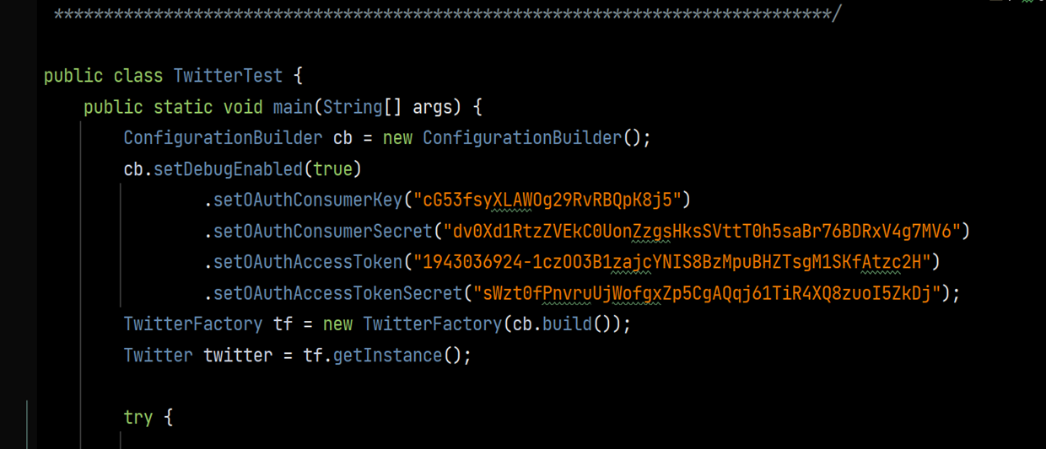
Data Source using a Twitter developer account

Slide 5
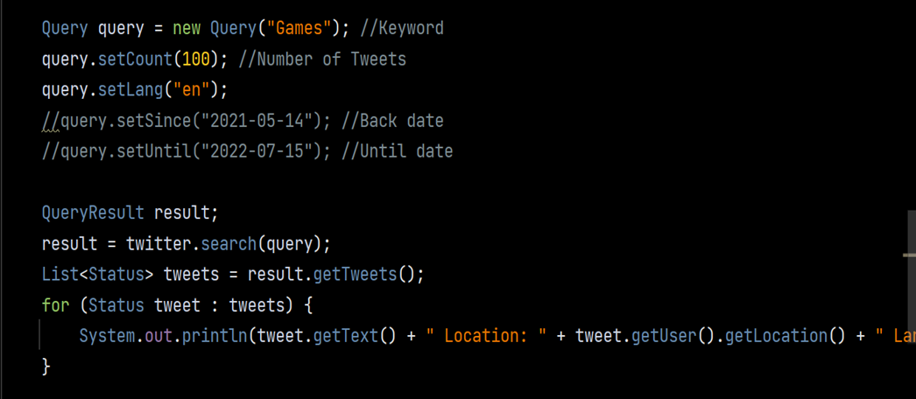
Data Collection
1. Games-related data
2.100 tweets at a time
3. Tweets from the English language
4. Dates according to data
5. Tweets format
6. Collection in a text file

Slide 6
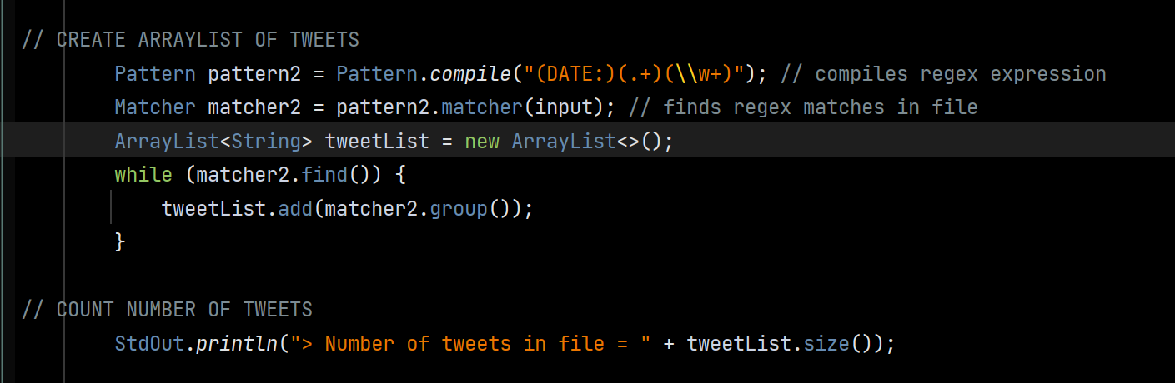
Count no of Tweets

Slide 7
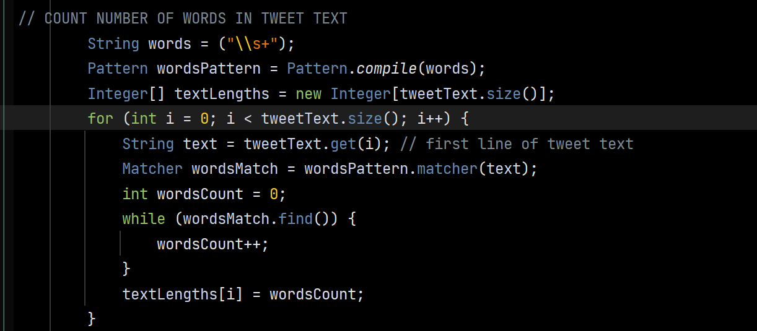
Count no of Words in a text file

Slide 8
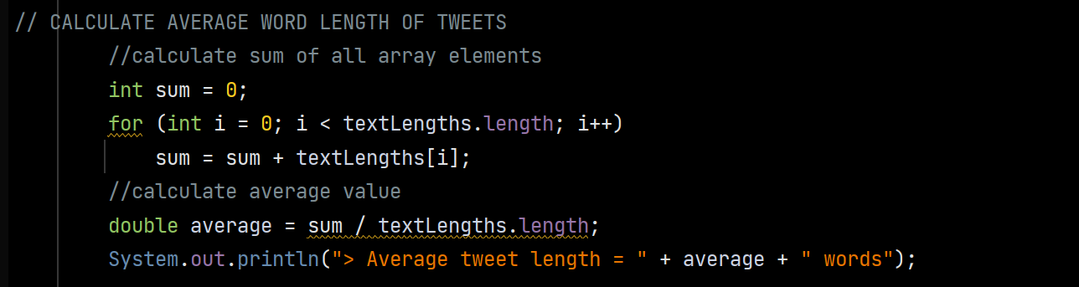
Count Average word length

Slide 9
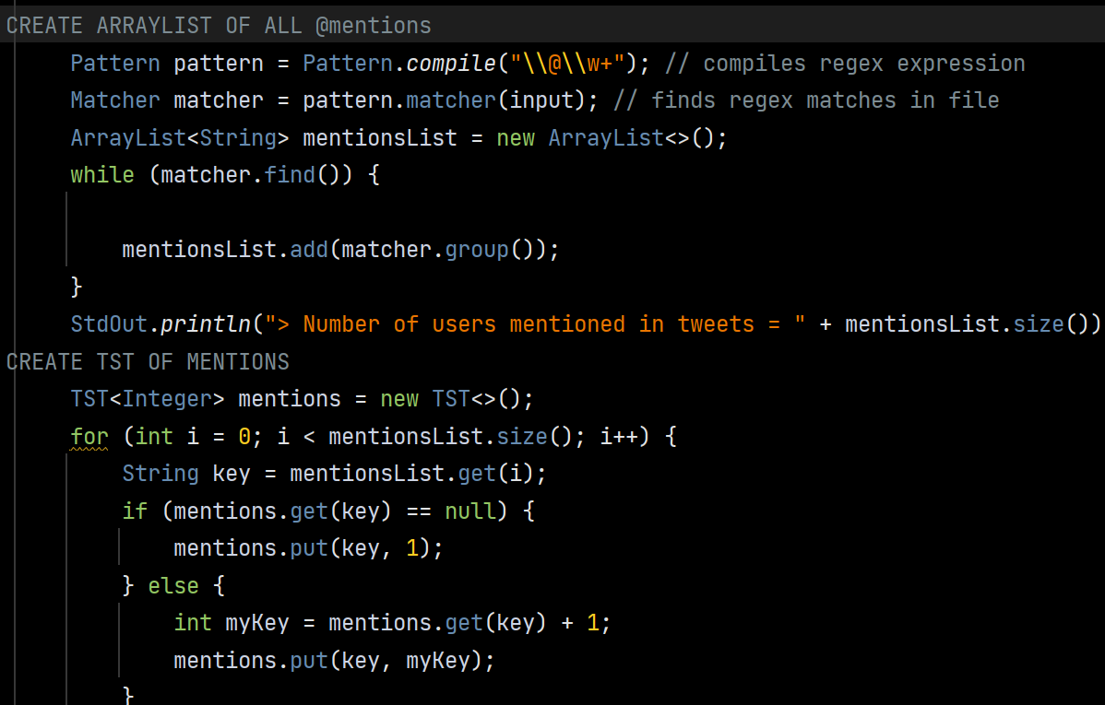
Arraylist and TST for mentions

Slide 10
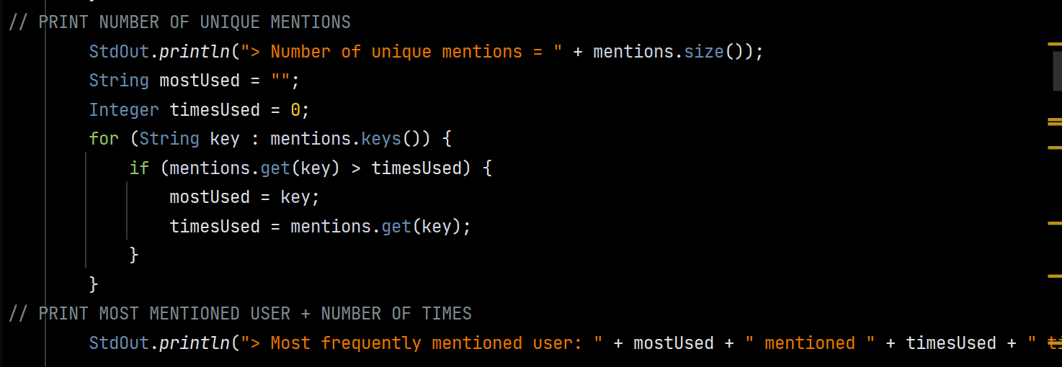
No of unique mentions in txt file

Slide 11
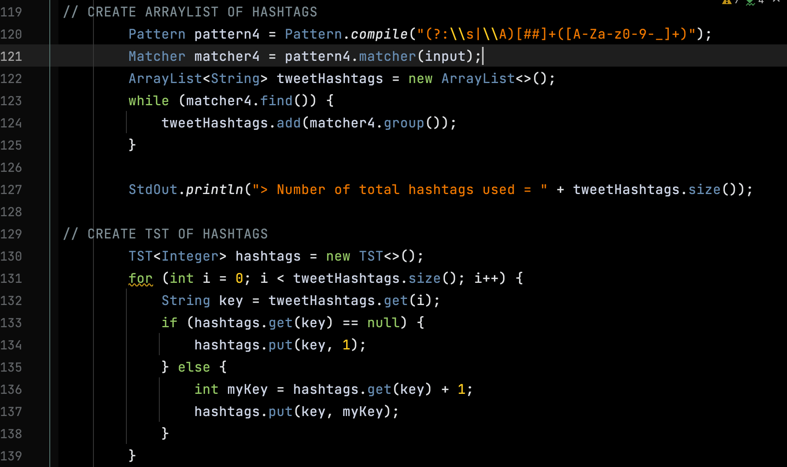
Hashtag Analysis : RegEx
Use RegEx Pattern to collect all hashtags
Use RegEx Matcher to search and match Patterns
Use while loop to count the number of hashtags in file

Slide 12
Hashtag Analysis : TST
Use TST to look at all the hashtags to count the unique number of hashtags
If new hashtag, count it. If existing hashtag, increment the count for that specific hashtag.

Slide 13
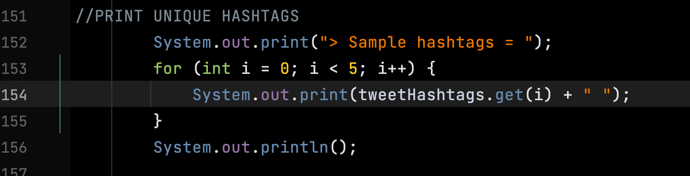
Hashtag Analysis : Unique#
Increment through and print a sample of five hashtags

Slide 14
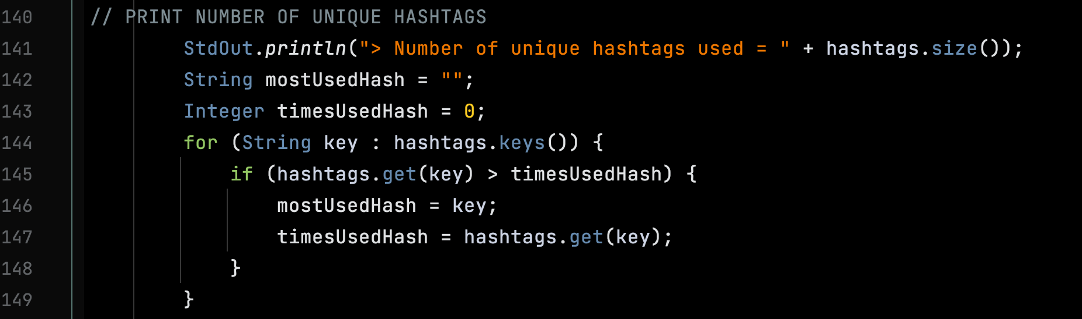
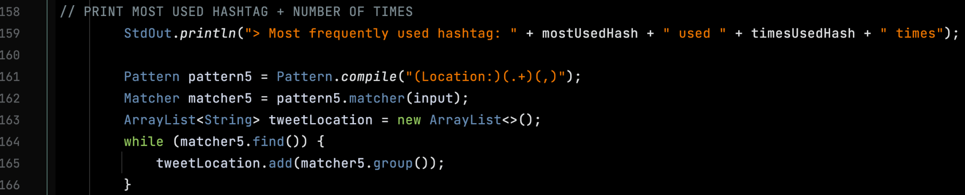
Hashtag Analysis : Get method
Display the unique number of hashtags by referencing the TST previously created
Use for loop to increment and find the most used hashtag, and the number of times it was used

Slide 15
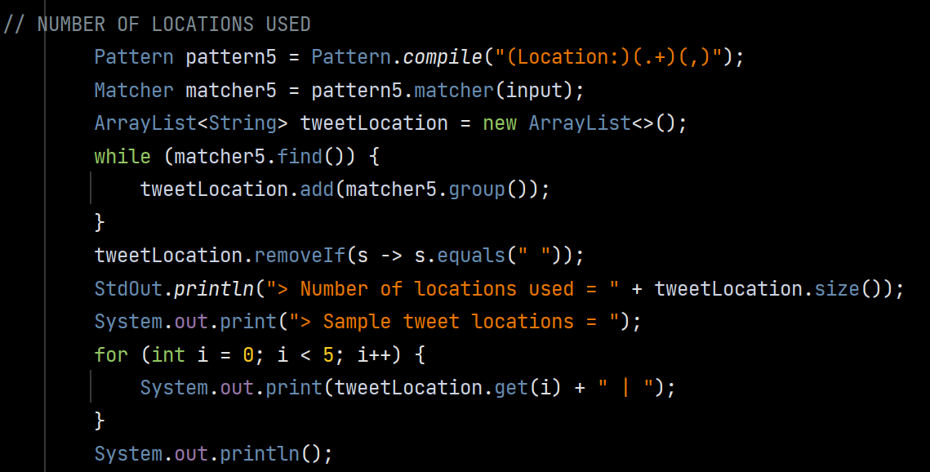
Location Analysis: Used

Slide 16
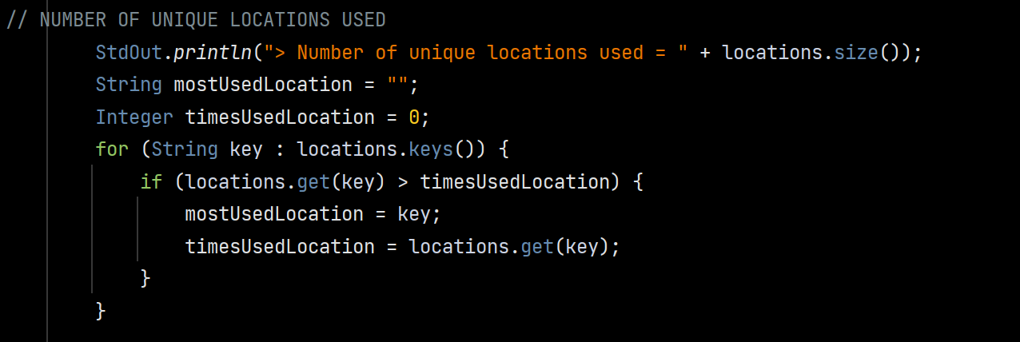
Location Analysis: Unique (TST)

Slide 17
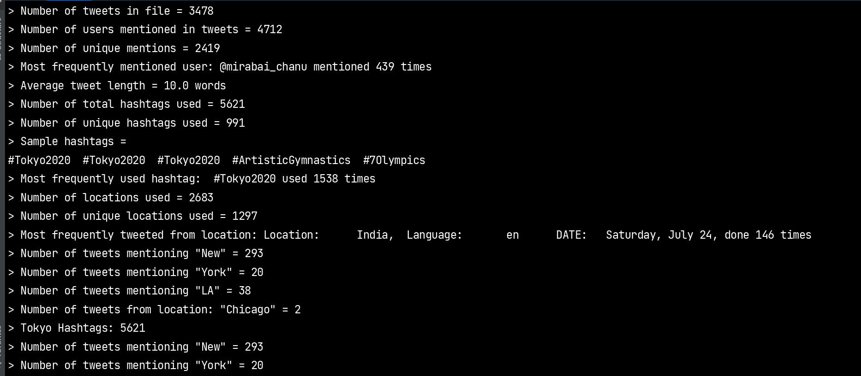
Output

Slide 18
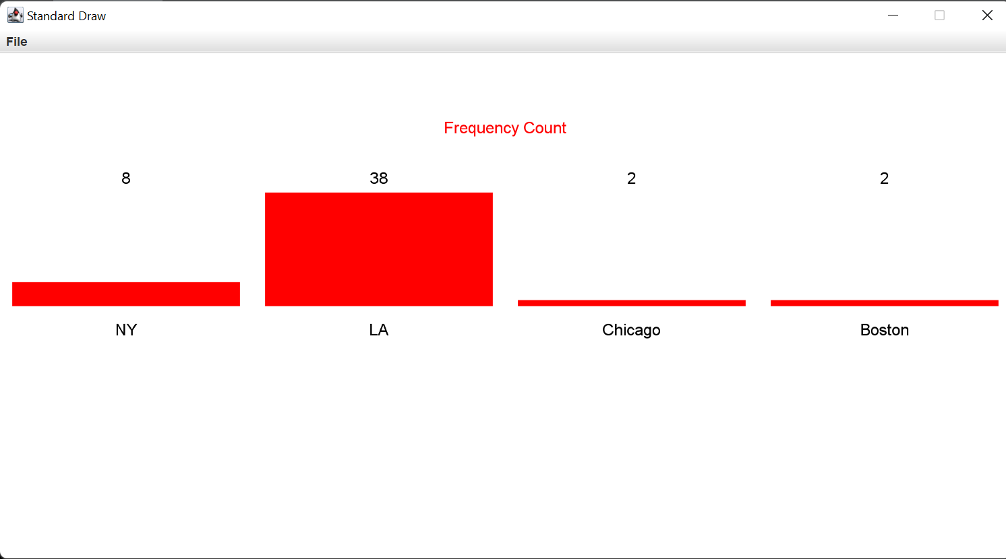
Statistics of different strings

Slide 19
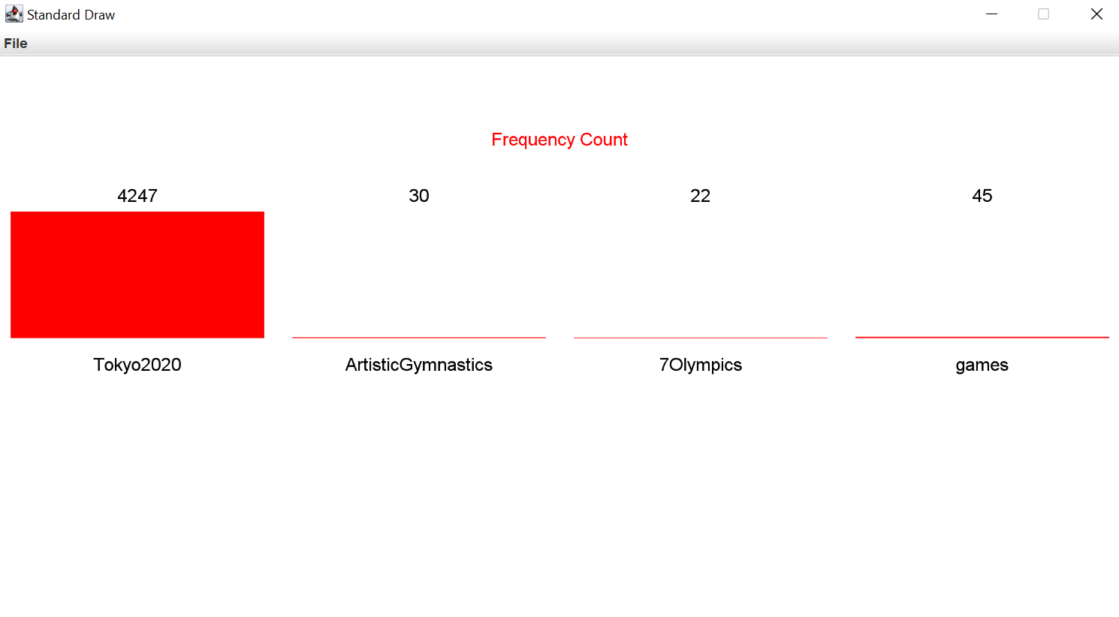
Statistics of different hashtags

Slide 20
Thank You ☺

